Slide 1
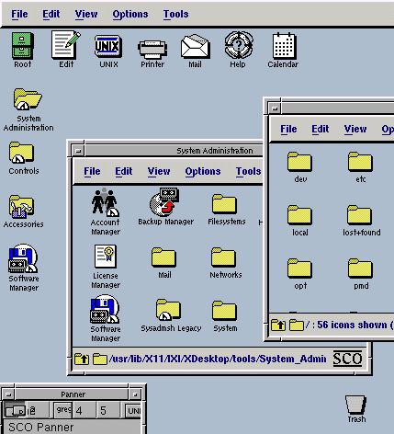
Python! Day 21
Intro to GUI
How to make more flexible functions

Slide 2
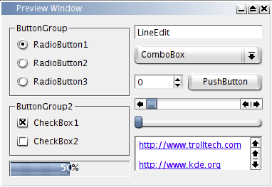
Introduction to GUI
A GUI or Graphical User Interface is a computer operating system that uses point-and-click windows, buttons, and images instead of just a screen of text
We’ve used GUI’s before with the turtle module
Today, we’re going to learn how to code using a GUI in Python through the tkinter module
The tkinter module is useful because it’s able to do more things than the turtle module – for example, it can create buttons of text input boxes on the screen
To start, let’s create a new Python project called “GUI Project”

Slide 3
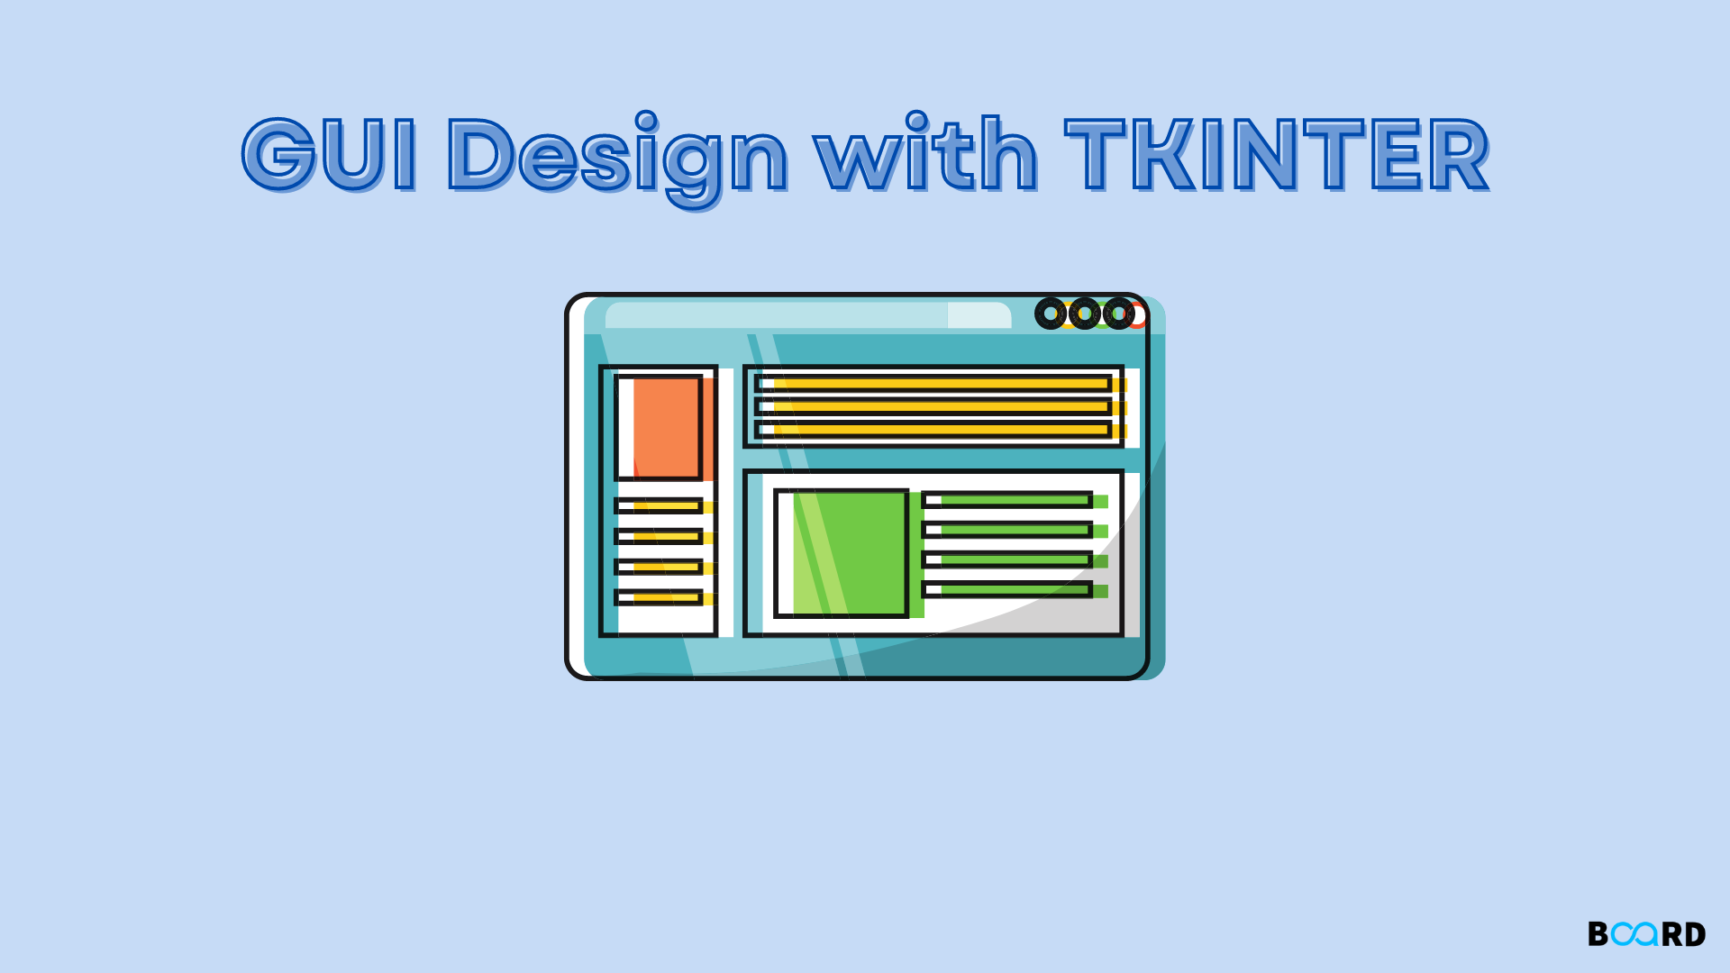
Introduction to Tkinter
The first thing we need to do in our new project is import tkinter
Tkinter is built into Python, so we don’t need to install it
Next, we can create a window:
import tkinter
window = tkinter.Tk()
Now, if we run our code, nothing will happen because the program immediately ends after the window is created, so we can’t see the window
To fix this, we can write window.mainloop() at the end of our program like how we write screen.exitonclick() when using turtle

Slide 4
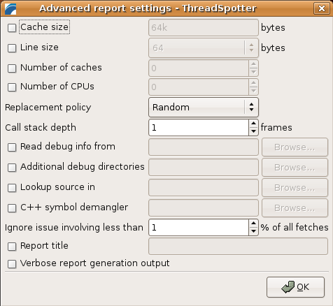
Editing the Window
We can edit the window like how we can edit the screen with the turtle module
We can write this to change the window’s title and default size:
window.title(“GUI Project”)
window.minsize(width=500, height=300)

Slide 5
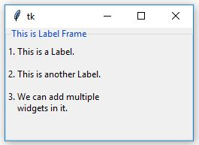
Creating a Label
Next, let’s put some text into our window
We can do this by creating a label
We can create a label like this:
label = tkinter.Label(text=“This is a Label”, font=(“Arial”, 18))
If we run our program now, our label won’t appear because we have to tell Python how and where we want the label to appear
The easiest way to do this is using the label.pack() function
To get the label to appear at the top of the screen, we can write:
label.pack()

Slide 6
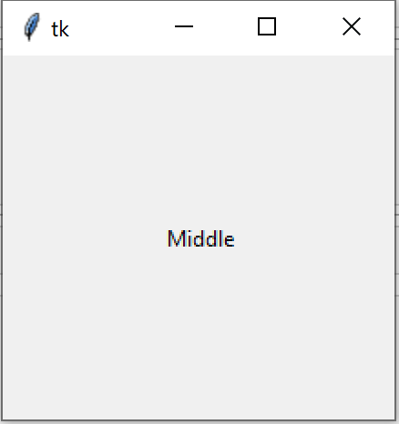
We can change where the label appears by giving an input to the pack function:
label.pack(side=“top”) or label.pack()
Aligns text to the top of the screen
label.pack(side=“left”)
Aligns text to the left of the screen
label.pack(side=“right”)
Aligns text to the right of the screen
label.pack(side=“bottom”)
Aligns text to the bottom of the screen
label.pack(expand=True)
Puts text in the middle of the screen

Slide 7
Functions with Optional Inputs
Now, we’re going to shift topics for a bit, so let’s temporarily comment out our previous code
So, you might have noticed that functions like turtle.write() have a whole bunch of optional parameters:
For example, if we write:
import turtle
t = turtle.Turtle()
t.write(“This is Text”, font=(“Arial”,22,”normal”))
We can also provide the function with a whole bunch of optional inputs, like a font

Slide 8
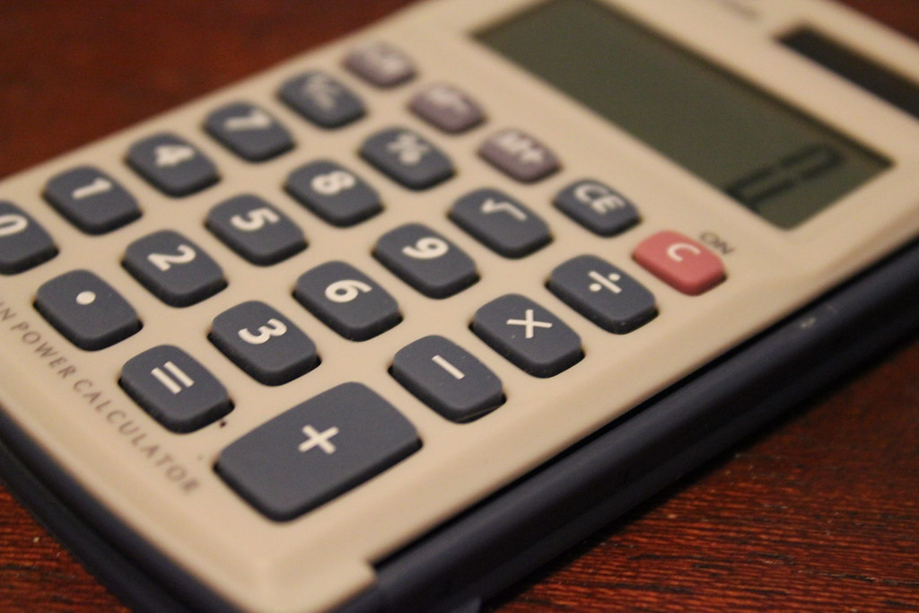
The write() function can do this because the function’s parameters have default values, including a default font
We can create a function with default input values like this:
def add(a=1, b=1, c=1): return a + b + c
add(a=3)
Now, if the user provides values for a, b, or c, the user’s input will override the default value
This Photo by Unknown Author is licensed under CC BY

Slide 9
Functions with Unlimited Optional Inputs
Currently, our add function can take at most 3 inputs, but what if the user wants many more inputs? Then, we can use *args to allow our function to have an unlimited number of inputs
We can do that by writing this:
def add(*args):
sum = 0
for num in args:
sum += num
return sum
add(1, 2, 3, 4, 5, 6, 7, 8)
Here, args is a tuple containing all of the user’s inputs

Slide 10
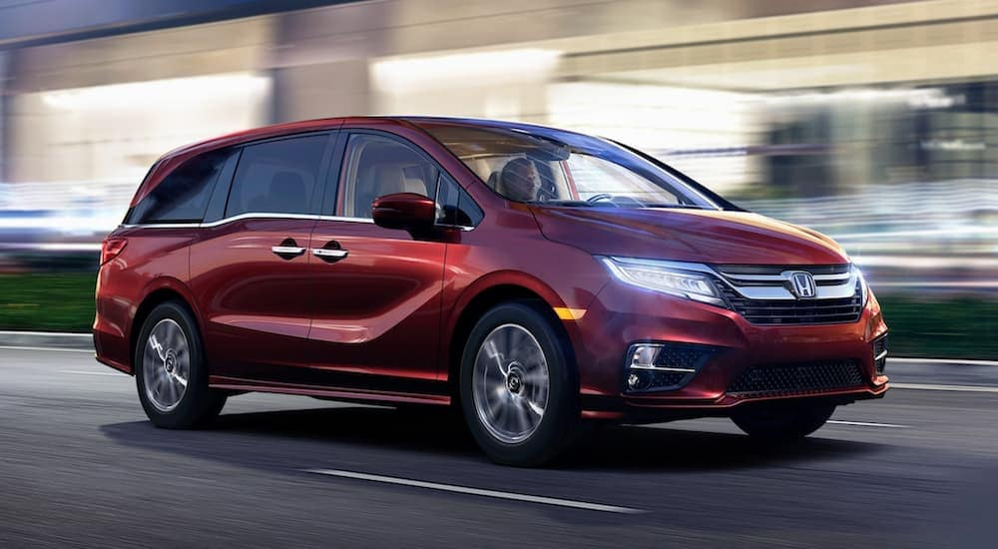
Functions with Unlimited Keyword Inputs
We can also create a function with unlimited keyword inputs (parameters that are referred to a name like height or size) like this:
def car(**kwargs):
print(kwargs)
car(make=“Honda”, model=“Oddessy”, color=“red”)
In this case, kwargs is a dictionary containing the user’s input

Slide 11
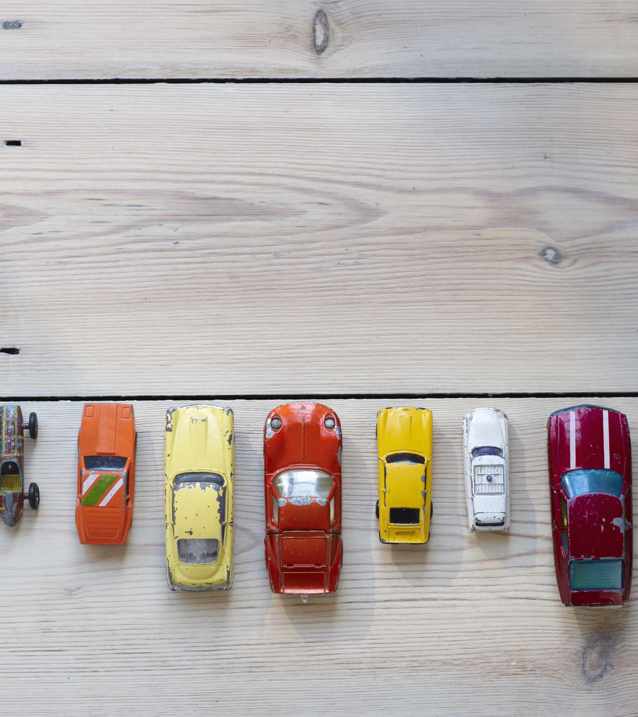
We can use kwargs input like this:
def car(**kwargs):
print(“Make: “, kwargs.get(“make”))
print(“Model: “, kwargs.get(“model”))
print(“Color: “, kwargs.get(“color”))
car(make=“Honda”, model=“Oddessy”, color=“red”)
We use the get() function here so that is the user doesn’t add a color input. For example, the color will equal None instead of causing an error
This is what tkinter uses for all of its inputs

Slide 12
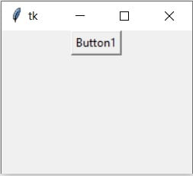
Creating a Button
Now, let’s get rid of all of this function stuff and go back to our tkinter code
Let’s create a button using tkinter:
button = tkinter.Button(text=“Click Me”)
button.pack()
Right now, if we run our program and click the button, nothing happens, so let’s fix that

Slide 13
Making the Button Work
To make the button work, first, we must create a function that will run whenever the button is clicked:
def button_clicked():
label.config(text=“Button was clicked”)
Now, let’s give this function to the button as an input
button = tkinter.Button(text=“Click Me”, command=button_clicked)
button.pack()

Slide 14
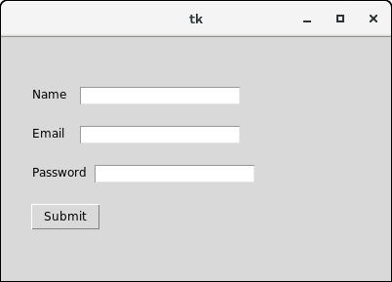
Creating a Text Entry
Next, let’s create a text entry box like this:
entry = tkinter.Entry()
entry.pack()
We can change the entry’s size like this:
entry = tkinter.Entry(width=10)
entry.pack()

Slide 15
Using a Text Entry
We can use the text inside the text entry using the entry.get() function
Let’s use it to change the text of our label to the text in the text entry whenever the button is clicked:

Slide 16
import tkinter
window = tkinter.Tk()
window.title("GUI Project")
window.minsize(width=500, height=300)
# Create a label
label = tkinter.Label(text="This is a Label", font=("Arial", 18))
label.pack()
# Create a button
def button_clicked():
label.config(text=entry.get())
button = tkinter.Button(text="Click Me", command=button_clicked)
button.pack()
# Create an entry
entry = tkinter.Entry(width=10)
entry.pack()
window.mainloop()

Slide 17
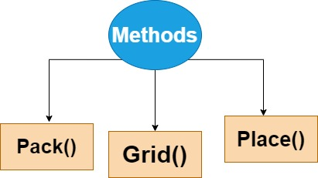
Tkinker Layout Managers
Currently, we’re placing all of our features using the pack() function, but there are two other layout managers in tkinter: place() and grid()
The nice thing about pack() is that it’s simple, but its downside is that it’s not very specific
place() works by providing specific x and y coordinates for each item. This is very precise but tiresome to code.
grid() is a mixture between the two that places each item relative to eachother based on its provided row and column
For example, an item in column 2 would be farther to the right than an item in column 1

Slide 18
Using grid() instead of pack()
Let’s try using grid() instead of pack() to place out features on our program
label = tkinter.Label(text="This is a Label", font=("Arial", 18))
label.grid(column=0, row=0)
button = tkinter.Button(text="Click Me", command=button_clicked)
button.grid(column=1, row=1)
entry = tkinter.Entry(width=10)
entry.grid(column=2, row=2)
Label
 | Button
 |  | Entry

Slide 19
Adding Padding to Our Window
Right now, all of our GUI features are crammed up against each other
We can change that by adding padding
For example, if we wanted to add padding to the window, we would write:
window.config(padx = 20, pady=20)
We can also do this to our labels, buttons, entries, etc., to make everything less cramped

Slide 20
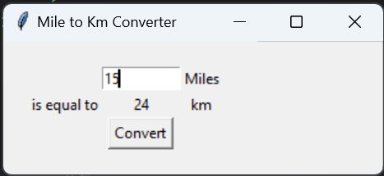
Project: Miles to Kilometers Converter
Now, let’s comment out all of our previous code and work on a small project
This project will create a program that accepts a value in miles from a text entry on a tkinter GUI and, after a convert button is clicked, displays the corresponding value in kilometers on the window
Hint: First, create and place all of the features using the grid() layout manager, then make the button work

Slide 21
def convert(): num_mi = int(mile_entry.get()) num_km = int(round(num_mi * 1.61, 0)) converted_km.config(text=str(num_km)) window = tkinter.Tk() window.title("Mile to Km Converter") window.config(padx=20, pady=20) mile_entry = tkinter.Entry(width=10) mile_entry.grid(column=1, row=0) mile_label = tkinter.Label(text="Miles") mile_label.grid(column=2, row=0) equal_label = tkinter.Label(text="is equal to") equal_label.grid(column=0, row=1) converted_km = tkinter.Label(text="0") converted_km.grid(column=1, row=1) km_label = tkinter.Label(text="km") km_label.grid(column=2, row=1) convert_button = tkinter.Button(text="Convert", command=convert) convert_button.grid(column=1, row=2) window.mainloop()

